Slide 1

Steam Genre Prediction - Data Science for Business Team Project
Team 44 - Sriya Vemuri, Amna Mahmood, Samir Dar, Kerry Chen, Calida Mathias

Slide 2
TABLE OF CONTENTS
01
04
02
05
03
06
Modeling
Business Understanding
Data Understanding
Evaluation
Deployment
Data Preparation and EDA

Slide 3
01
Business Understanding

Slide 4

About Steam
Steam is the world’s largest digital distribution platform for PC gaming, developed by Valve Corporation. It hosts over 50,000 games and serves as the main storefront where developers publish and market their games.

Slide 5
Business Problem
Choosing the right genre tags on Steam store pages affects: Game discoverability and ad targeting; Bundle placement and influencer outreach.
This current process relies on intuition and competitor checks, leading to:
1ST
2ND
3RD
Missed secondary genres
Inconsistent tagging across teams
Delayed Launched

Slide 6
Data Mining Solution
Built a data-mining assistant to predict game genres from early metadata
Inputs:
Outputs:
platform, price, screenshots, trailers, developer history
Ranked genre tags with confidence scores
Offers:
Highlights key drivers:
precision vs. reach threshold options
platform type, price, and media richness

Slide 7
02
Data Understanding

Slide 8
DATA Understanding
Source
Merged Steam dataset from Kaggle with ~66,900 games and 31 variables describing title, genre, pricing, platform, and developer details
Data Issues
Originally uncleaned with mixed types, missing values, and semi-structured JSON fields
DATASET
team_appid, name, genres, price_overview, is_free, required_age, platforms, supported_languages, developers, publishers, screenshots, and movies
Key Variables
Biases & Patterns
Windows games dominate vs. Mac and Linux-based; Genres overrepresented (e.g. Action and Indie); Tagging practices vary across developers (causing class imbalance)

Slide 9
03
Data Preparation and EDA

Slide 10
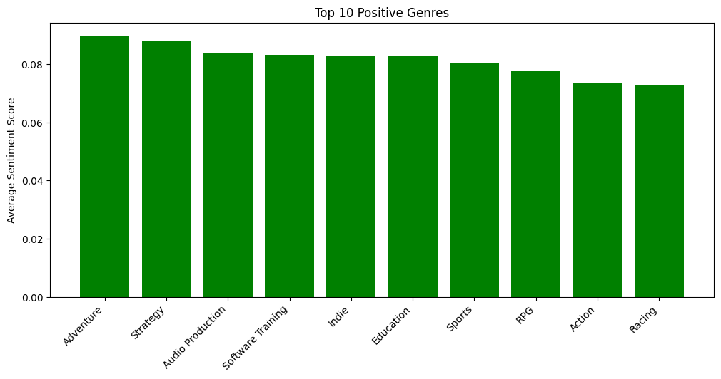
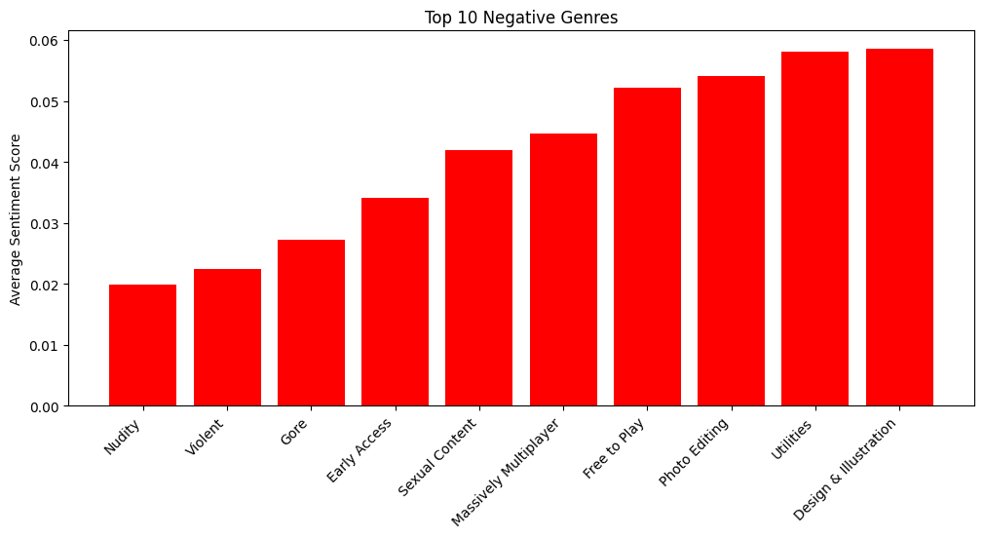
Genre Analysis
Sentiment reflects engagement differences between gameplay and productivity-focused titles.
Players respond most positively to Adventure and Strategy genres.
Utility and Design apps trend more negatively.

Slide 11
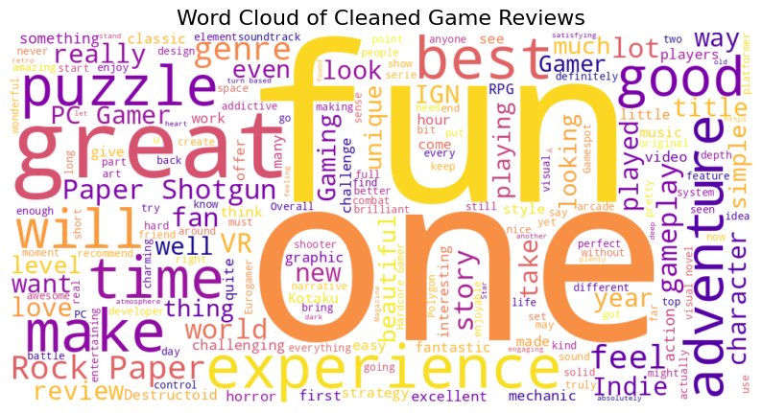
Sentiment Analysis

Slide 12
04
Modeling

Slide 13
Models Used
Transform early metadata into ranked genre predictions with confidence scores, helping studios make faster, data-driven tagging decisions.
Logistic Regression
Random Forest
Linear SVC
Simple, interpretable, shows feature influence
Handles non-linear patterns & missing data well
Effective for high-dimensional, multi-genre prediction

Slide 14
05
Evaluation

Slide 15
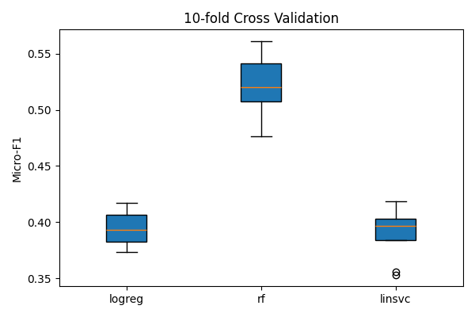
Model Comparison (10-Fold Cross Validation)
~0.5203
~0.3953
~0.3902
Random Forest
Logistic Regression
Metric Used: Micro-F1 score (mean ± standard deviation)
Linear SVC

Slide 16
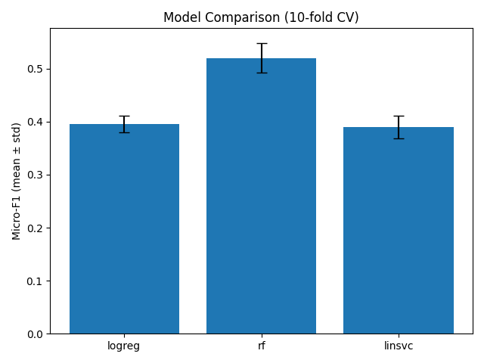
Interpretation
Performance Summary
Class Imbalance Impact
Class Imbalance Impact
Random Forest: Best overall by Micro-F1 and Hamming loss
Fewest per-label tagging errors
Macro-F1: low across models (~0.17–0.20)
Rare genres have near-zero recall
Weighted-F1: slightly favors LogReg/SVC

Slide 17
06
Deployment: A Genre Tagging Assistant

Slide 18
Deployment Plan
developer enters game details
model suggests several likely genres
Each suggestion includes a confidence score
Purpose: help studios and publishers assign the most accurate genres to a new game before launch
1
2
3

Slide 19
Benefits
Speed
Reduces time spent on manual genre selection
Deployment
Consistency
Applies a standard, data-driven logic to all titles
Insight
Moves away from guesswork toward analytics
Evolution
Model will be regularly retrained with new Steam data to adapt to market trends and
new games

Slide 20
Deployment Considerations
Practical Challenges
Ethical Guidelines
Data Quality is Crucial: The model's accuracy depends on complete input. Missing information like pricing or media can weaken its predictions.
Regular Maintenance: The gaming landscape changes fast. The model needs frequent updates to recognize new genres and trends.
User Trust & Transparency: The tool must be easy to use and understand. It should clearly explain which features influenced its recommendations to build developer confidence.
Human in the Loop: This is a support tool, not a final decision-maker. Developers must always review and approve its suggestions.
Bias Awareness: The model learns from existing data and may favor popular genres. Results for niche games must be reviewed with extra care.
Data Integrity: All training data is from publicly available Steam metadata, ensuring no privacy or ethical conflicts.

Slide 21
Risk Mitigation
Outdated Metadata
Implement a schedule for regular model retraining using the latest game data
Balance the training data during updates to give appropriate weight to both popular and niche genres
Bias Toward Common Genres
Risks
Over-
reliance on Tool
Establish a clear workflow that requires human review and final approval for all genre tags
Technical Complexity
Keep the tool's architecture simple, maintain clear documentation, and ensure it is easy to support

Slide 22
THANK YOU!

